Slide 1
PID No:
TG0922825
10th Edition TECHgium®
Presentation Round
Self-Diagnosing Edge Nodes That Know When Their Data Can’t Be Trusted
Author 1
Photo
Author 2
Photo
Author 3
Photo
Author 4
Photo
Shriram
Santhosh K
Suresh R
Srijith T
Easwari Engineering College, Chennai, Tamil Nadu
Notes:
Team intro. One line: "Our concept is Sentinel, for PS 40 Self-Diagnosing Edge Devices."

Slide 2

Challenge Statement
Field devices rarely fail loudly. They drift, overheat or lose a wire, and keep sending numbers that look fine. Someone then travels out, guesses the cause and swaps the whole unit.
What PS 40 asks for
4 °C off
and nothing looks wrong
1
Check itself on the chip
no cloud, no person watching
2
Catch faults while running
heat, noise on a sensor line, a cut bus
3
Show what it costs
flash, RAM, CPU duty, extra current
4
Prove it
accuracy per fault, and how a fleet rolls up
Notes:
Problem in 30 seconds. Point at the chart: the red line drifts 4 degrees over a month and nobody notices because every value still looks reasonable. Then read the four asks on the right. Those four asks are how we structured the rest of the deck.

Slide 3
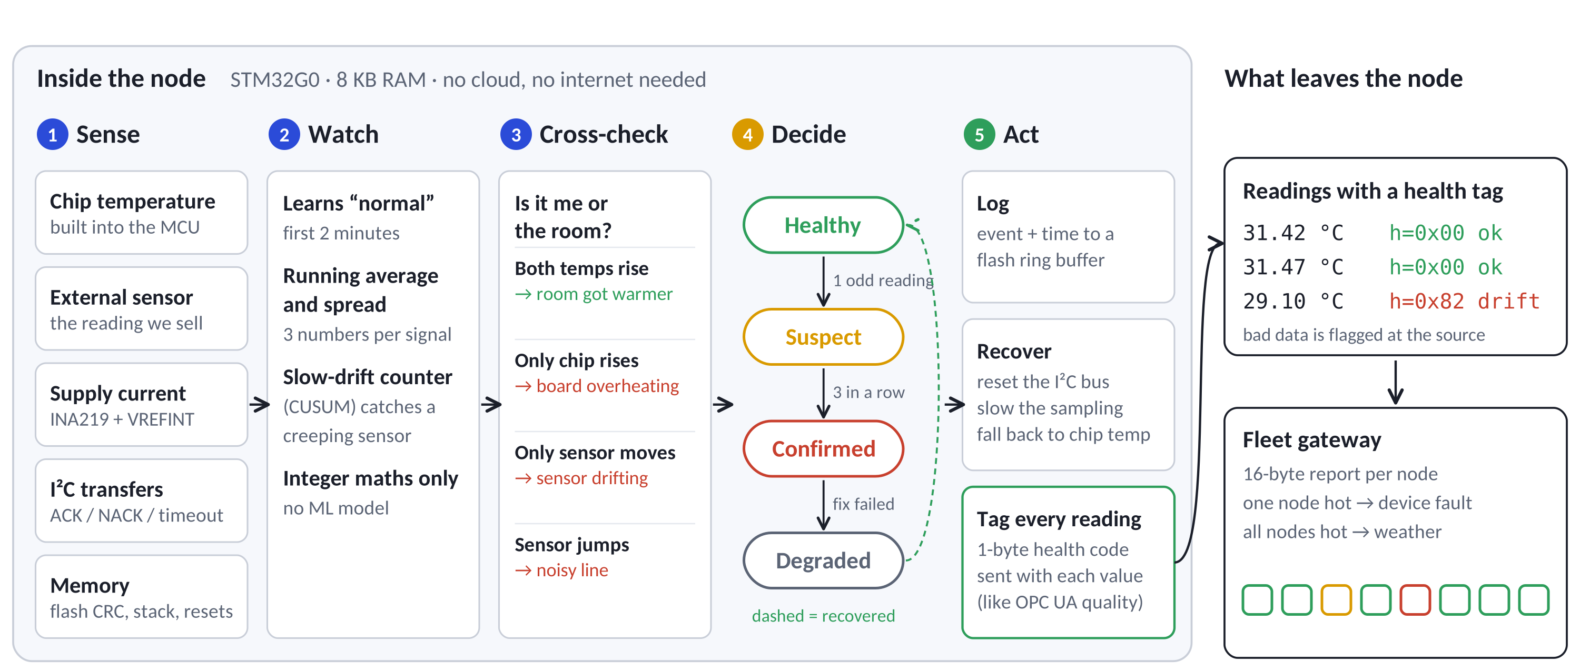
Concept / Proposed Solution
Sentinel is a small firmware layer that runs beside the application on a sub-$1 MCU. Every second it checks the board, the sensor and the wiring, and every reading leaves the node with a 1-byte health tag.
Notes:
Walk left to right. 1 Sense: five signals the chip already has or gets cheaply. 2 Watch: it learns what normal looks like in the first two minutes. 3 Cross-check: this is the key idea, it compares the external sensor with the chip's own thermometer so it can tell "the room got warmer" from "I am broken". 4 Decide: a four-state machine so one odd sample never raises an alarm. 5 Act: log, try to recover, and tag every reading. Whoever receives the data knows instantly whether to trust it.

Slide 4
Pros and Cons of the solution
Against the usual ways of doing this
Strengths
 | Fixed thresholds | Cloud analytics | Sentinel
Works with no network | Yes | No | Yes
Tells weather from a fault | No | Needs fleet data | Yes
Catches slow sensor drift | Late | Yes | Yes
Fits in 8 KB of RAM | Yes | No | Yes
Says why it raised an alarm | Yes | Often not | Yes
Runs on the node, offline
No new parts apart from a current monitor
Every alarm comes with a plain reason
One code base for any sensor node
Limits we know about
Needs 2 minutes after install to learn “normal”
Chip-to-sensor heat lag is matched once per board design
Very small faults can slip by (noise ±0.5 °C, +1.3 mA)
It flags and works around faults; it cannot repair hardware
Same simulated runs, two detectors (validation slide has the method)
26 → 0
21/30 → 30/30
fixed thresholds → Sentinel
false alarms in 30 normal runs with a 3–8 °C weather swing
fixed thresholds → Sentinel
slow sensor drifts caught within 3 minutes
Notes:
The comparison numbers are not opinions, they come from running a plain threshold detector and Sentinel on the exact same simulated data. A fixed threshold panics every time the weather changes: 26 false alarms out of 30 normal runs. Sentinel had zero because it checks the chip temperature against the sensor. Be upfront about the limits, the jury respects that.

Slide 5
Technical Description
Two witnesses before any alarm
The health byte sent with every reading
What the node sees | What it means | Flag
Chip and sensor warm up together | Weather changed | none
Chip warms, sensor does not | Board is overheating | HEAT
Sensor moves, chip stays flat | Sensor is drifting | DRIFT
Sensor jumps sample to sample | Noise on the sensor line | NOISE
I²C transfer fails or times out | Bus is broken | BUS
Rail current shifts and stays | Abnormal power draw | POWER
Flash CRC or stack canary changes | Memory is corrupted | MEM
State
MEM
PWR
BUS
NOISE
DRIFT
HEAT
bit 7
bit 0
State: 00 healthy · 01 suspect · 10 confirmed · 11 degraded
Example: 0x82 = confirmed + sensor drift
The drift check, from our firmware (shortened)
// sensor minus chip temp, vs. normal
z = res - res_mu;
up = max(0, up + z - k);
dn = max(0, dn - z - k);
if (dn > h && chip_rising) flag(HEAT);
else if (up > h || dn > h) flag(DRIFT);
// k = 2σ, h = 8σ, all values in 0.01 °C
Rules inside the firmware
Learns “normal” for 120 s
Drift: CUSUM, 2σ slack, alarm at 8σ
Confirm after 3 hits in a row
Clear after 10 clean samples
Radio bursts ignored (min of 3)
Integer maths only; no divide in the loop
Notes:
The heart of the method is the table on the left: we never trust one signal alone. Room temperature moves both thermometers, a broken board moves only the chip, a bad sensor moves only the sensor. On the right is the one byte that travels with every reading. Top two bits are the state, the rest are fault flags. If asked about CUSUM: it is a running score that grows a little every second the sensor is slightly off, so slow drifts add up until they cross a limit.

Slide 6
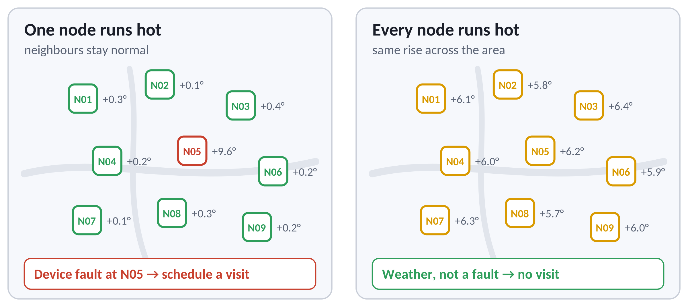
Technical Description
Fleet roll-up: each node sends a 16-byte report; the gateway compares neighbours
node id
health
seen
uptime (s)
last fault (s)
°C
V
CRC
2 B
1 B
1 B
4 B
4 B
1 B
1 B
2 B
Sent every 60 s
about 0.3 bytes per second per node, fine for LoRa or RS-485
Any link
UART, RS-485, LoRa, or a cellular modem at the site
Neighbours as reference
one node off its neighbours is a device fault; all moving together is the environment
Corrupt report? Dropped
CRC-16 over the first 14 bytes
Illustration of the gateway rule; values are examples.
Notes:
PS asks how reports are aggregated across a fleet. Each node sends a fixed 16-byte report once a minute. The gateway groups nodes by location. The picture shows why that matters: if one node is hot it is that device, if all of them are hot it is the weather and nobody needs to drive out.

Slide 7
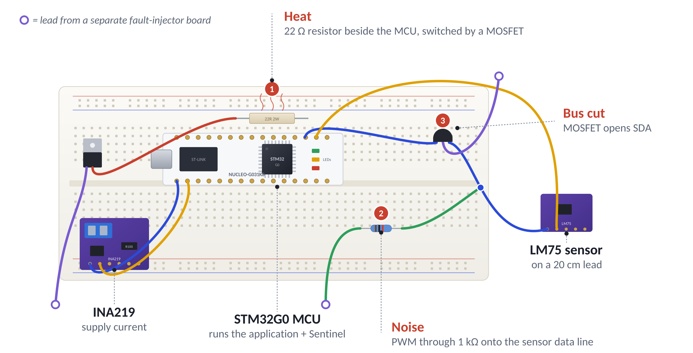
Implementation Plan
Bench rig: the node under test and three fault switches it cannot see coming
Notes:
This is how we will break the device on purpose. 1 Heat: a 22 ohm resistor right next to the MCU, switched by a MOSFET. 2 Noise: a PWM signal pushed through 1 kilo-ohm onto the sensor data line. 3 Bus cut: a small MOSFET that opens the SDA wire. All three are driven from a separate injector board, so the node has no hint. The LM75 sits on a 20 cm lead so the heater warms the chip but not the sensor, which is exactly what the cross-check looks for.

Slide 8
Implementation Plan
Already done
Next six weeks, on hardware
W1
W2
W3
W4
W5
W6
Firmware written
about 150 lines of C, integer only
Build the rig
wire board, sensor lead, fault switches
Builds for STM32G0
arm-none-eabi-gcc 13.2, Cortex-M0+
Calibrate
baselines, heat lag, current with a bench meter
Footprint measured
same app built with and without Sentinel
Fault campaign
30 runs × 5 faults + 30 normal runs
180 simulated runs
the same C code, compiled for a PC
Fleet demo
3 nodes + gateway, live health board
What the jury will see on the day
1
Judge flips a fault switch
2
LED goes amber, then red
3
Serial log shows h=0x81
4
Gateway marks that node
Notes:
Left: what exists today, not promises. The firmware is written, it compiles for the real chip, and the footprint numbers on the next slide come from that build. Right: six weeks to move it onto hardware and repeat the same 30-run campaign. Bottom: the live demo flow. h=0x81 means confirmed plus heat.

Slide 9
Validation / Testing / Analysis
Simulation with the same C code. 30 runs per fault, 900 s each, 1 sample/s. Fault size varied every run; a 3–8 °C weather swing in every run.
Cost on the chip (A/B build, STM32G0)
+1.7 KB flash
+144 B RAM
5.3% of a 32 KB part
+56 B peak stack; 1.8% of 8 KB
< 0.1% CPU
Δ mA current
Fault | Median time | Slowest | Missed
Heat | 29 s | 57 s | –
Noise | 4 s | 15 s | 3, all ±0.5 °C
Bus cut | 2 s | 17 s | –
Drift | 49 s | 155 s | –
Power | 9 s | 22 s | 1, +1.3 mA
~6.6k instructions per second at 16 MHz (estimate)
measured on the rig, Sentinel on vs off
0
false alarms
in about 18 hours of normal operation: 30 fault-free runs plus the time before every injected fault
Thresholds were tuned on separate runs; these numbers come from a fresh set. Hardware runs will replace them.
Notes:
Be clear these are simulation results, using the exact firmware code compiled for a PC, and say hardware runs are next. Highlights: bus faults in 2 seconds, heat in about 30, slow drift in under a minute typically. Misses are only the smallest injected faults. Zero false alarms across about 18 hours of normal data. Right side: the footprint numbers are from a real compile for the STM32G0, the CPU figure is an estimate from counting instructions in an emulator, and current will be measured on the rig.

Slide 10
Cost Estimate
Prototype bill of materials
Cost per deployed node
Item | Role | ₹ | Source
NUCLEO-G031K8 board | node under test | 2,458 | LionCircuits
INA219 module | supply current | 289 | Probots
LM75 sensor module | external temperature | 78 | Quartz Components
22 Ω 2 W resistor, 3 MOSFETs, 1 kΩ, breadboard, leads | fault rig | ≈350 | our estimate
Fault injector + gateway | spare Arduino and a laptop | 0 | already owned
One node + rig |  | ≈3,175
Fleet demo, 3 nodes |  | ≈8,825
₹0
extra silicon for self-diagnosis. If the node already has an MCU, Sentinel is just firmware.
US$0.97
STM32G030F6P6, single unit at LCSC. The whole MCU, not just our share of it.
Optional: an INA219 only where the board does not already measure its supply current.
Prices checked on the sellers’ sites, November 2026, single units incl. GST where listed.
Notes:
The prototype costs about three thousand rupees per node, most of it the development board. In a real product the self-diagnosis costs nothing extra in hardware, it is firmware that runs on the MCU the device already has. The STM32G030 itself is under a dollar.

Slide 11
Assumptions
1
The node has two thermometers
the MCU’s internal sensor plus at least one external sensor in the same space (true for STM32G0 and most MCUs).
2
The first 2 minutes are clean
Sentinel learns “normal” right after install or reset.
3
Heat lag is matched once
chip and sensor react to the room with different delays; we match it per board design, not per unit.
4
One sample per second is enough
faster sampling only shortens detection time; it does not change the method.
5
Faults come from outside
a separate injector board drives every fault, so the node gets no hint.
6
Simulation values are ours
noise levels and fault sizes are our estimates; hardware runs will replace them.
Notes:
Six assumptions. The important one to explain if asked is number 3: the chip warms up faster than an external sensor, so we smooth the chip reading to match. That is a one-time calibration per board design.

Slide 12
References
Method
E. S. Page, “Continuous Inspection Schemes,” Biometrika, vol. 41, 1954. (CUSUM)
S. W. Roberts, “Control Chart Tests Based on Geometric Moving Averages,” Technometrics, vol. 1, 1959. (EWMA)
R. Isermann, Fault-Diagnosis Systems: An Introduction from Fault Detection to Fault Tolerance, Springer, 2006.
OPC Foundation, OPC UA Part 4: Services, StatusCode (Good / Uncertain / Bad data quality).
Hardware
STMicroelectronics, STM32G030x6/x8 datasheet and RM0454 reference manual (STM32G0x0).
Arm, Cortex-M0+ Technical Reference Manual (no hardware divider).
Texas Instruments, INA219 current/power monitor datasheet.
NXP, LM75A digital temperature sensor datasheet.
Prices (Nov 2026)
lioncircuits.com: NUCLEO-G031K8 · probots.co.in: INA219 module
quartzcomponents.com: CJMCU-75 LM75 module · lcsc.com: STM32G030F6P6 (C724040)

Slide 13
Thank You

